Slide 1

NetLock: Fast, Centralized Lock Management Using Programmable Switches
Zhuolong Yu
Yiwen Zhang, Vladimir Braverman, Mosharaf Chowdhury, Xin Jin

Slide 2




Increasing demand of database services
Lock managers are a critical building block of cloud databases

Slide 3

The lifetime a transaction
Can I read/write that resource?
Let me check…
Lock Manager

Slide 4
The lifetime a transaction
Lock Manager
Read
Write

Slide 5
The lifetime a transaction
I’m done with the resource
Ok, I’ll release it
Lock Manager
Read
Write

Slide 6

The lifetime a transaction
In-memory database, RDMA networks
(FaRM [SOSP’15], DrTM [SOSP’15])
I will …….. try
I can read/write very fast now. Can the LM be faster?
Lock Manager
Read
Write

Slide 7

Performance and policy support
 | High performance | Policy support
Centralized lock manager | Bottleneck at the server’s capacity | Flexible
Decentralized lock manager | Usually good | Hard to support
DrTM [sosp’15] uses blind fail-and-retry
high client CPU usage
Can we have both?
Exponential back-off
high latency
Distributed queues
extra network round-trips
DSLR [sigmod’18] avoids starvation in a decentralized manner, but it cannot support other policies.

Slide 8
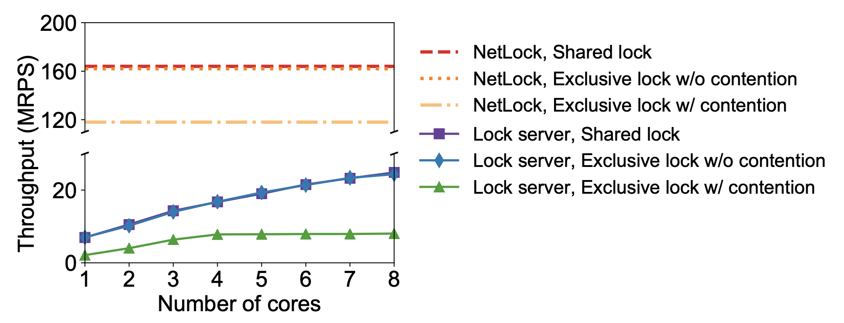
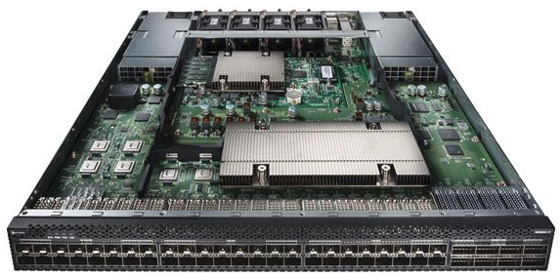

PISA: Protocol Independent Switch Architecture
What if we implement the centralized lock manager in a switch?
Then we can have both advantages!
Eliminate the bottleneck at the lock server
Programmable switch

Slide 9
PISA: Protocol Independent Switch Architecture
Programmable Parser
Parse custom key-value fields in the packet
Programmable Match-Action Pipeline
Read and update key-value data at line rate
Match + Action
Memory
ALU
…
…
…
…
Programmable Parser
Programmable Match-Action Pipeline

Slide 10

Design goals for NetLock
High throughput
Low latency
Flexible policy support
They are directly achieved by using high performance switches, and a centralized approach.
Challenges:
Limited memory to store the locks
Limited functionalities to process the locks and realize the policies

Slide 11
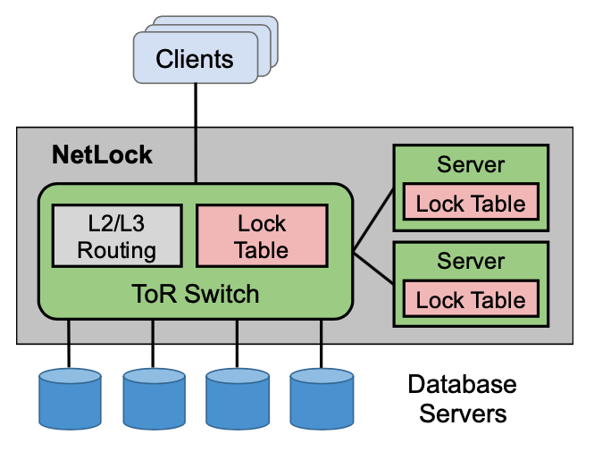
NetLock architecture
NetLock processes lock requests with a combination of switch and servers.
The switch only stores and processes the requests on popular locks.
NetLock is incrementally deployable and compatible with existing datacenter networks.

Slide 12
Packet format
Existing Protocols
NeLock Applications
ETH | IP | UDP | Action type | Lock ID | Lock mode | Txn. ID
L2/L3 routing
reserved port #
Acquire / Release
Shared / Exclusive

Slide 13
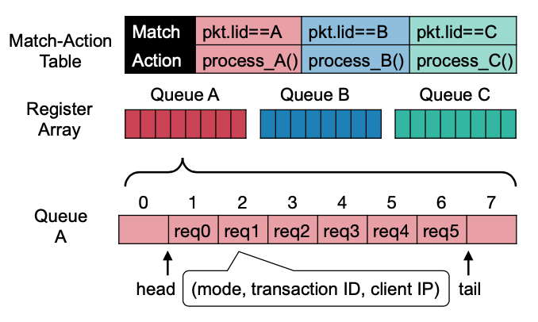
Memory layout
ETH | IP | UDP | Action type | Lock ID | Lock mode | Txn. ID
Circular queues
Extra register to keep the head and tail pointers

Slide 14
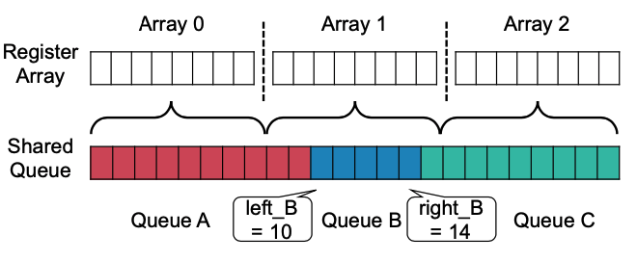
Memory layout
All the locks share a large queue
Extra registers to store the boundaries

Slide 15
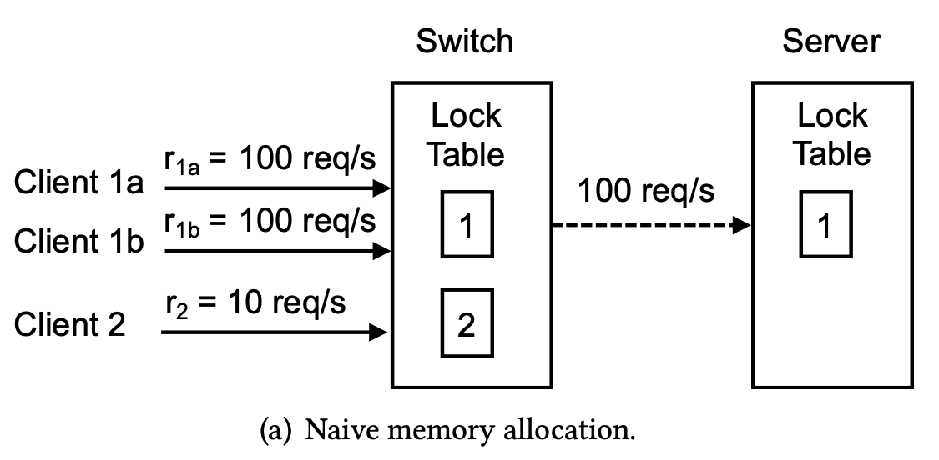
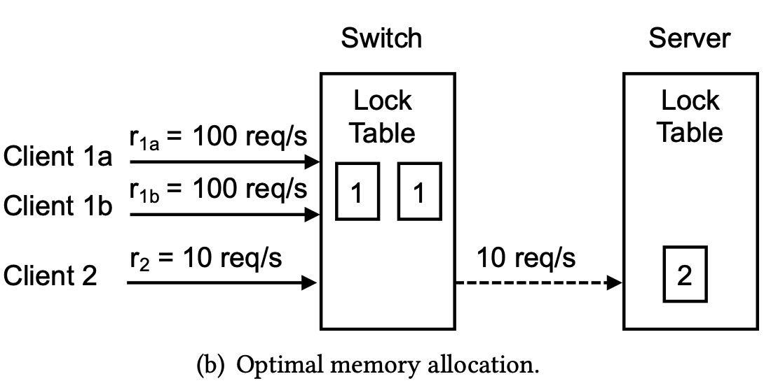
Memory allocation
NetLock memory allocation
Process as many lock requests in the switch as possible
Clients send lock requests to NetLock without knowing where the requests will be processed

Slide 16



Processing the locks
Resubmit and notify
S
S
S
E
S
S
S
E
S
Release
Only one memory access (read/write) to a register array upon one packet
Write
I want to read
I am done
R
R
R
W
R

Slide 17
Policy support
Starvation-freedom
The requests are in a FCFS queue
Service differentiation with priority
One priority per stage
Low-priority can be offloaded to the lock servers
Performance Isolation
A rate limiter is implemented to enforce a quota for each tenant

Slide 18
Evaluation
Testbed
6.5 Tbps Barefoot Tofino switch
12 servers with an 8-core CPU and a 40G NIC
Comparison
DSLR, DrTM (RDMA based)
NetChain (Programmable Switch)
Workload
Microbenchmark (simple lock requests)
TPC-C with 1/10 warehouse per node

Slide 19
Evaluation
How fast can NetLock process lock requests?
What’s the benefit of NetLock on transaction performance over existing solutions?
Can NetLock provide flexible policy support?
How’s does NetLock handle failures?
This talk

Slide 20
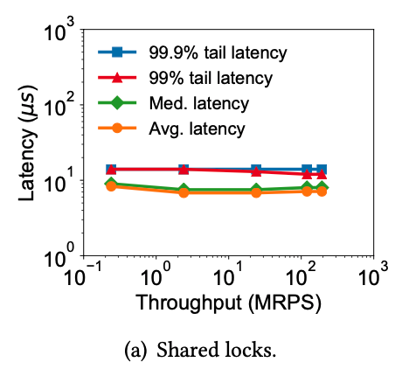
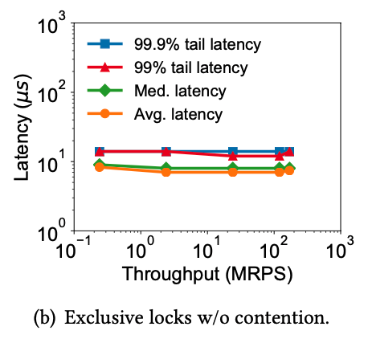
Evaluation: Microbenchmark
12 servers cannot saturate the switch which is able to process billions of packets per second.

Slide 21
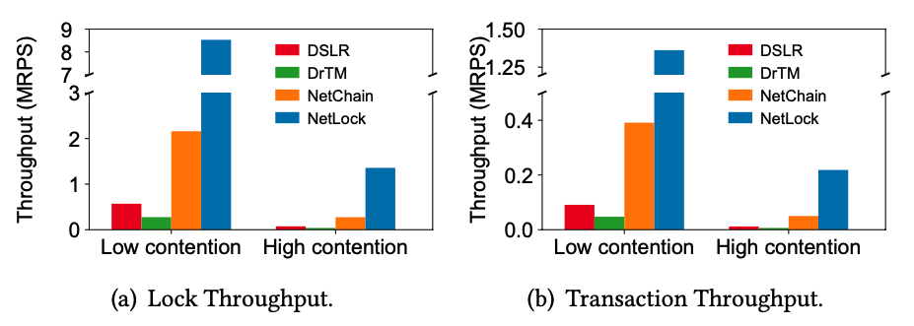
Evaluation: Transaction performance
NetLock improves the throughput by 14.0-18.4x compared with DSLR.

Slide 22
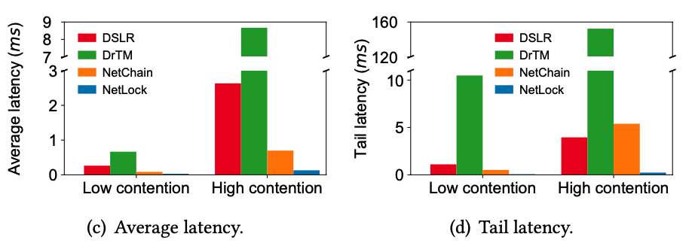
Evaluation: Transaction performance
NetLock also reduces the latency by 4.7-20.3x compared with DSLR.

Slide 23
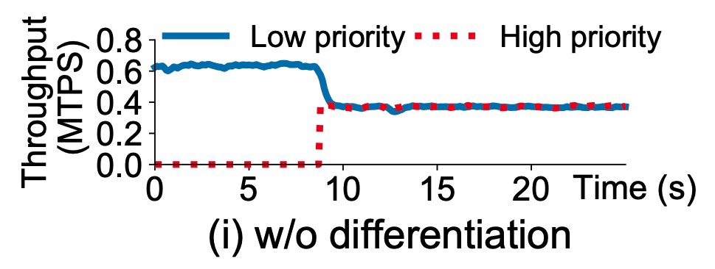
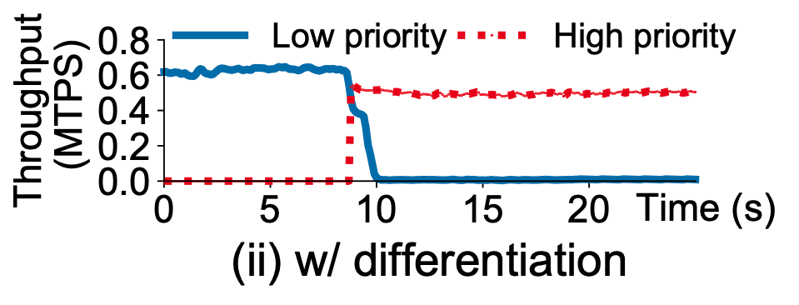
Evaluation: Service differentiation
Two clients get similar throughput regardless of priority
High priority client gets much higher throughput

Slide 24
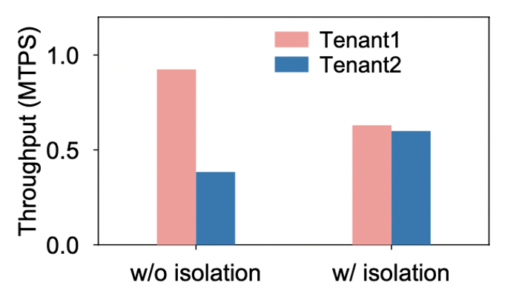
Evaluation: Performance isolation
Tenant 1 has 7 clients
Tenant 2 has 3 clients
After enforcing isolation, two tenants get similar throughput.

Slide 25
Conclusion
NetLock is a centralized lock manager
Co-design programmable switches and servers
Provide high performance and flexible policy support

Slide 26
Thank you

